Slide 1

NUCLEAR FISSION

Slide 2
STUDY OF NUCLEAR FISSION OF U₉₂²³⁵ WITH THERMAL NEUTRONS INTO XENON & SRONTIUM ISOTOPE FRAGMENTS
By ANURIYA RAVEENDRAN
SBAWMPH001
Under the guidance of
M.G.V SANKARACHARYULU

Slide 3
Nuclear Reactions:
The process of production of new nuclei and elementary particles in collision of particles and nuclei is called nuclear reaction
It can be elastic or inelastic scattering depending upon the nature of their projectile and ejectile.
Nuclear reactions are classified as :
Scattering process
Knockout process
Transfer process
Direct reaction
Compound reaction
Resonance reaction
Generally its classified to two- nuclear fission and nuclear fusion.

Slide 4
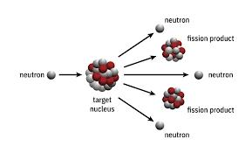
Nuclear fission:
Nuclear Fission is a reaction in which the nucleus of an atom splits into two or more smaller nuclei. The fission process often produce the gamma photons and release a large amount of energy even by energetic standards of Radioactive decay.
There are several types of fission reactions, distinguished by the type of particles that induce the fission and the specific isotopes involved. They are:
Spontaneous fission
Induced fission
Photofission
Electron-induced fission
Proton-induced fission
Symmetric fission
Asymmetric fission
Binary fission
Tertiary fission
Controlled fission

Slide 5
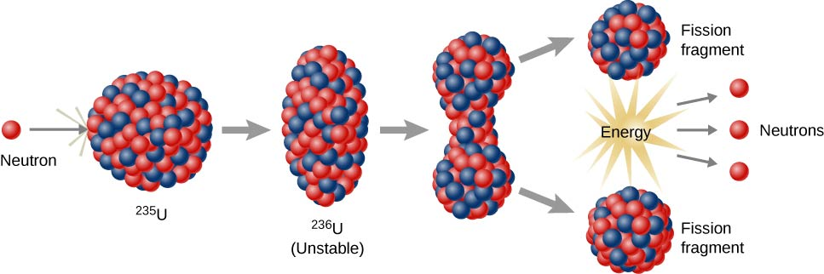
Induced fission of U²³⁵₉₂ with thermal neutrons into Xe₅₄¹⁴⁰ and Sr₃₈⁹⁴ is investigated using liquid drop model and quantum mechanical model with shell energy corrections.
_{LIQUID DROP MODEL}
Liquid drop model can explain the phenomenon of nuclear fission. A liquid drop has a spherical shape due to internal molecular forces responsible for surface tension. On applying large external force,the sphere may change into ellipsoid. If the external force is sufficiently large ,ellipsoid kay change into dumb bell shape.
According to Bohr –Wheeler theory, the nucleus behaves like a liquid drop. When the nucleus capture a neutron falling on it, it forms a compound nucleus which is highly energetic.

Slide 6
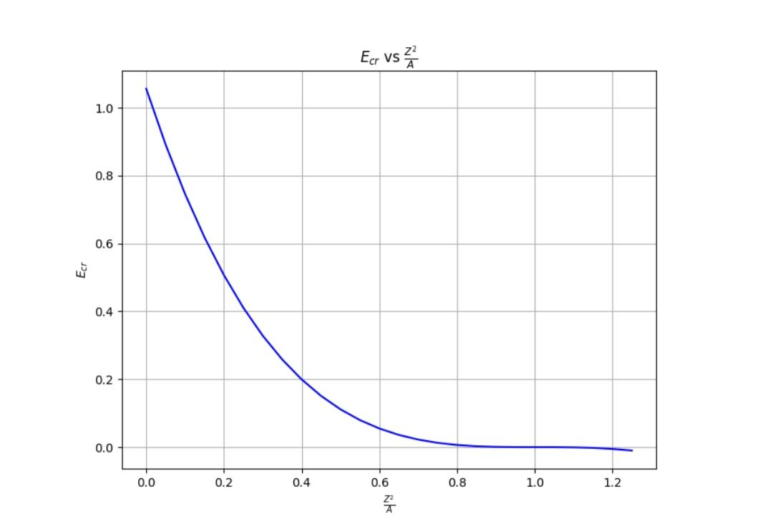
Critical energy as a function of Z² / A
Critical energy is measured using liquid drop model.
Liquid drop model does not consider the spin of fragments and their coupling.

Slide 7
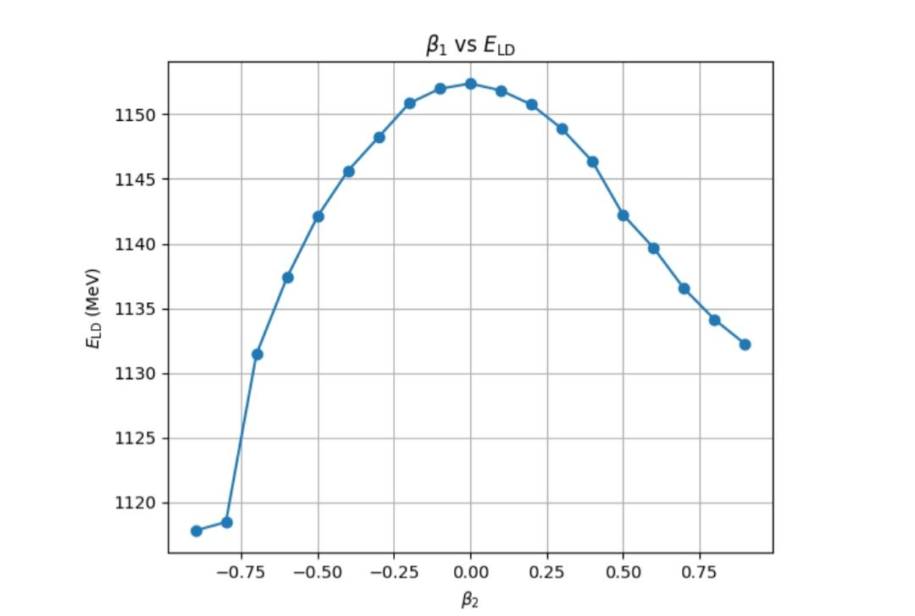
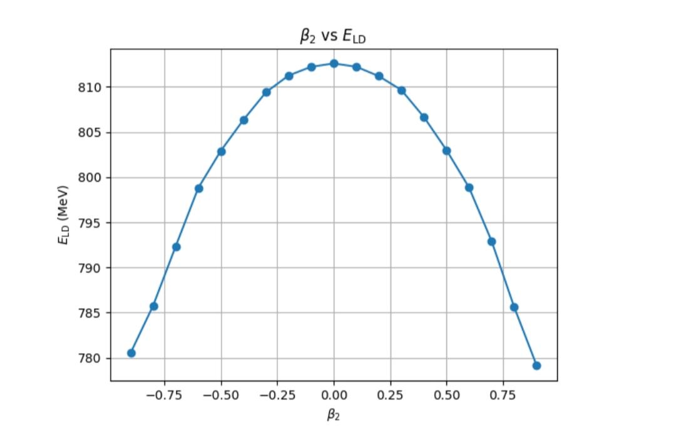
2. Liquid drop energy of individual fragments(Xe $ Sr) as a function of deformation parameter .
E_{L.D}= E_{v} – E_{s} – E_{c} + E_{sym} + E_{pair.}

Slide 8
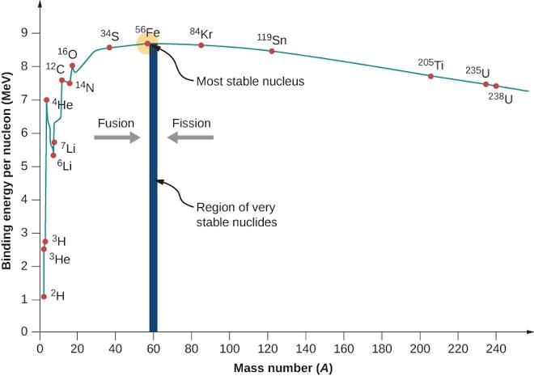
3.Energy release in fission
One of the most striking properties in fission process is the magnitude of energy released per fission, which is about 200MeV as compared with several MeV for other nuclear reactions. The amount of energy released per fission can be considered by binding energy curve
Binding energy per nucleon as a function of mass number(A):

Slide 9
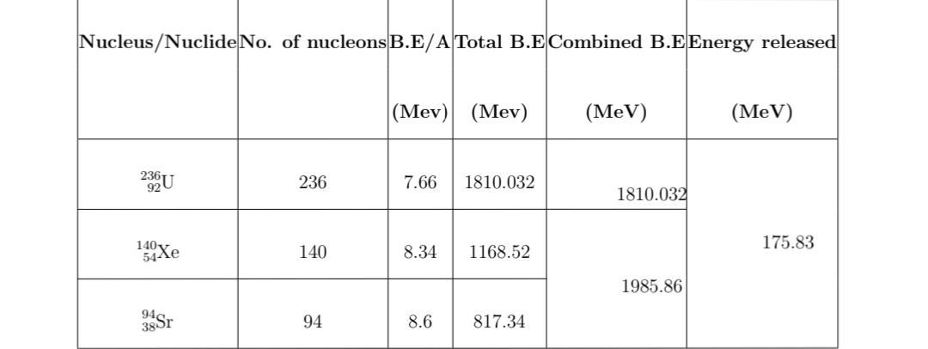
Energy released in fission ( asymmetric):
U₉₂²³⁶ Xe₅₄¹⁴⁰ + Sr₃₈⁹⁴ + 2n₀¹

Slide 10
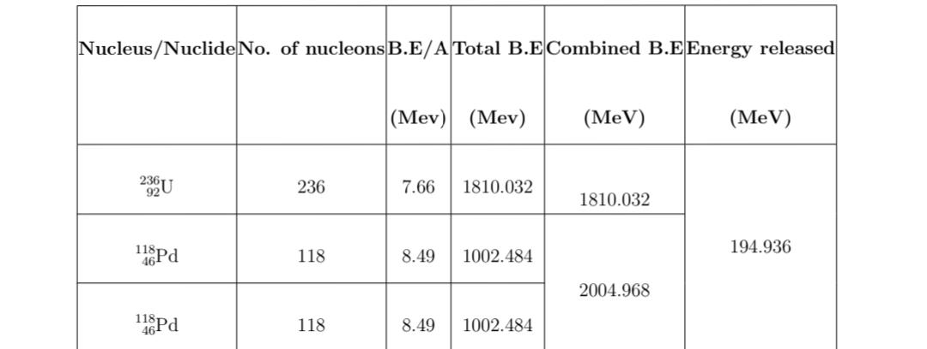
Energy released in symmetric fission:
U₉₂²³⁶ Pd₄₆¹¹⁸ + Pd₄₆¹¹⁸

Slide 11
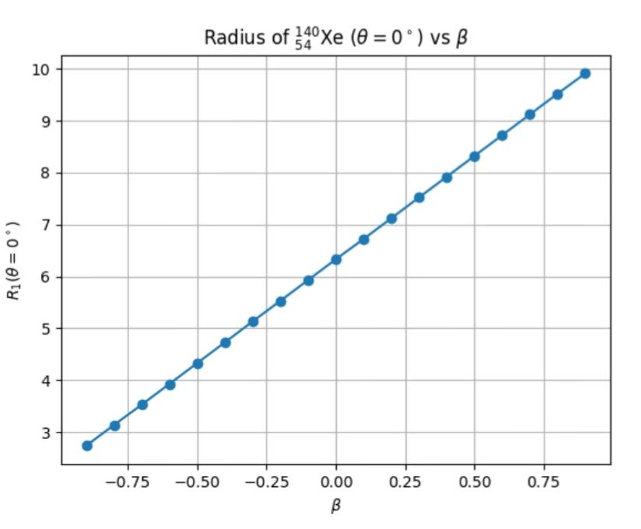
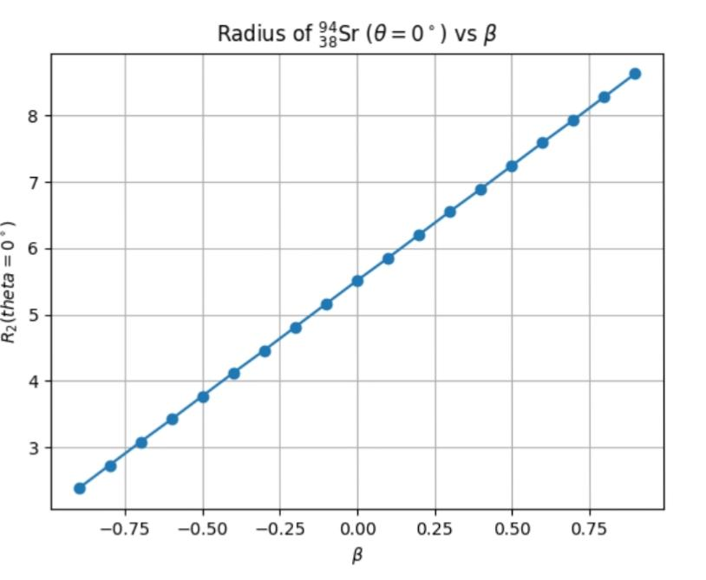
4.Change in radius of nuclei as a function of deformation parameter.

Slide 12
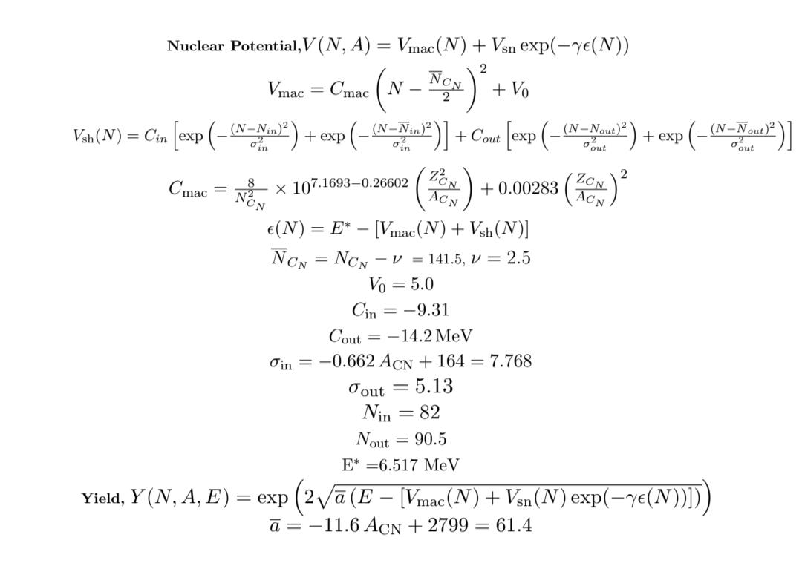
5. Nuclear Potential and Yield
The probability of formation of a particular fragment is called fission yield.

Slide 13
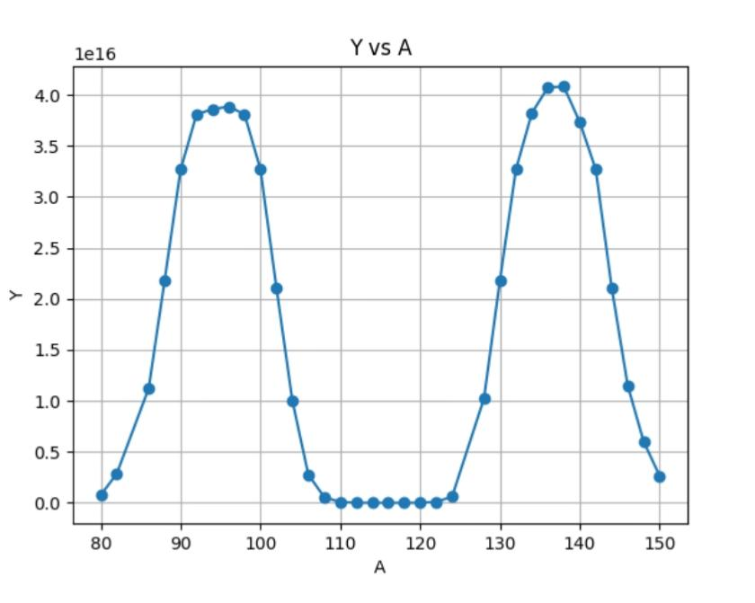
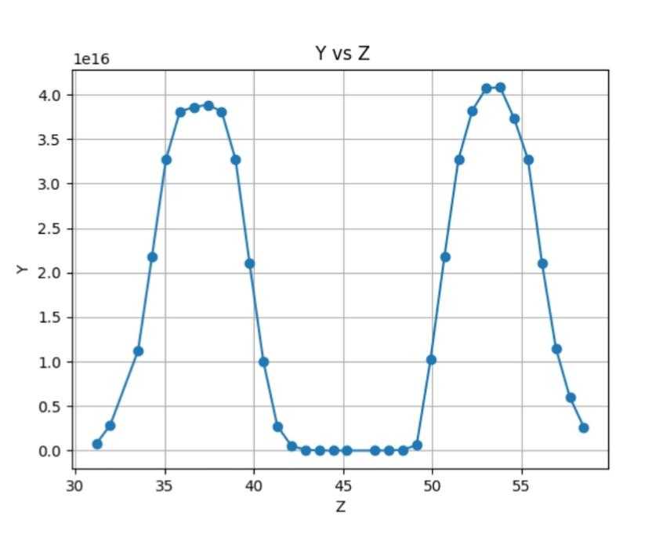
▪︎Yield as a function of ▪︎yield as function of
Mass number ( Y vs A ) Atomic number ( Y vs Z)

Slide 14
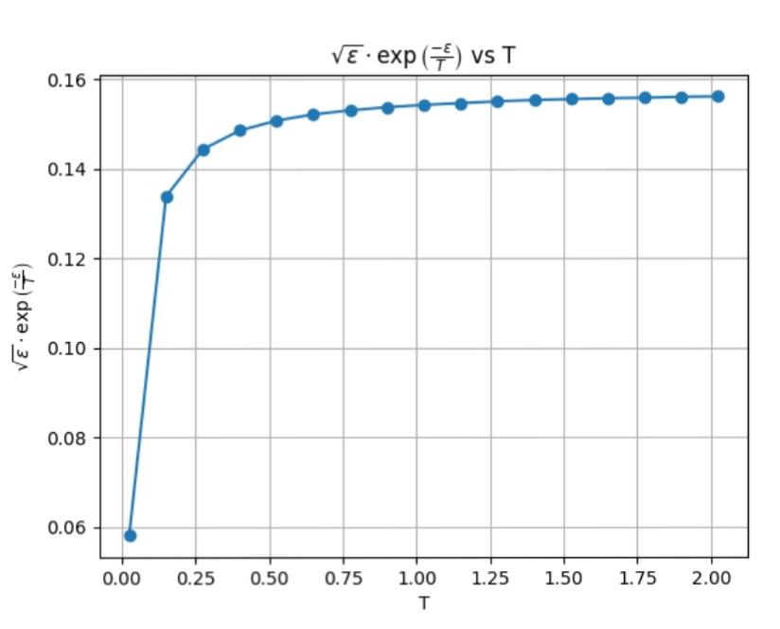
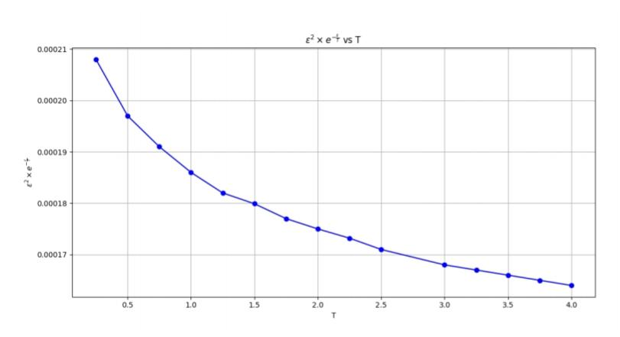
6.Nuclear energy distribution
Using the quantum mechanical model, we reproduced the experimental yield neutron distribution and plotted as a function of temp and epsilon.

Slide 15
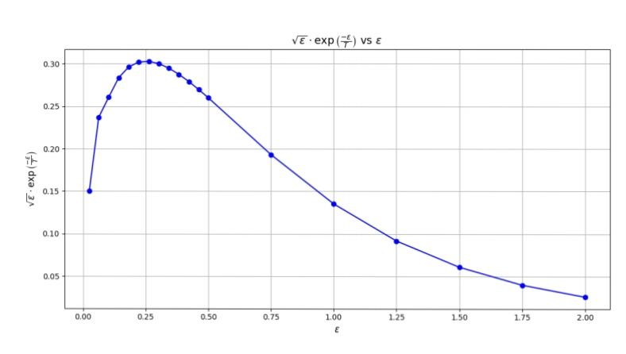
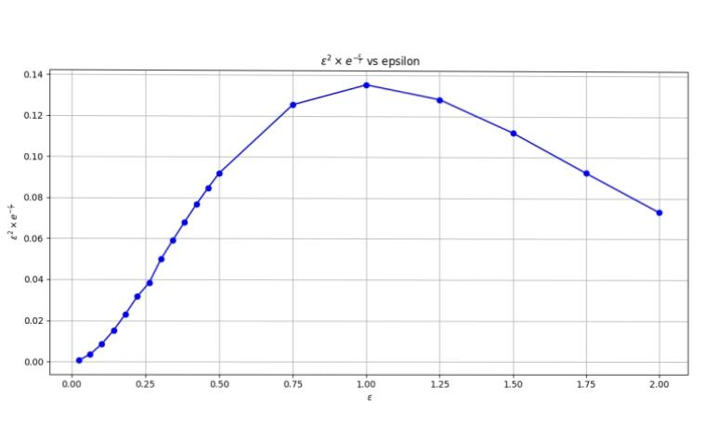

Slide 16
Result :
Critical energy as a function of Z² / A is plotted.
E_{L.D} of individual fragments and their isotopes as function of beta is plotted.
Change in radius of nucleus as function of deformation parameter is tabulated.
Projectile energy and excitation energy of neutron is calculated.
Nuclear potential and yield distribution of A of fragments, N of fragments and Z of fragments are measured and plotted.
Neutron distribution curves are plotted at different temperatures of the fissile nucleus.

Slide 17
Conclusion;
Yield of fission fragments distribution is calculated using QM model and is plotted
Experimentally measured yield and calculated yield are similar.
Asymmetric mass distribution of fragments is only explained by QM model. Liquid drop model if fail here.
Using QM model we reproduced experimental yield neutron distribution and is plotted.

Slide 18


